Slide 1
COVID Mobility Trends
Movement trends in US populations during the COVID pandemic
Yancy Liao

Slide 2
Overview
COVID-19 Open Data
Google’s Mobility Data
Stringency Index
Maintained by Google, it has daily time series data of over 500 variables for over 20,000 locations.
E.g., daily new cases, total cases, vaccinations, hospitalizations, search queries, etc.
Anonymized, aggregated mobility data at different regions for different categories of locations.
Only reported as a percentage change (%) from baseline - January 2020. Heavily influenced by time of the year.
An overall index for how severe a government’s movement restrictions are (100 highest, 0 lowest).
Can compare stringency index with mobility data.

Slide 3
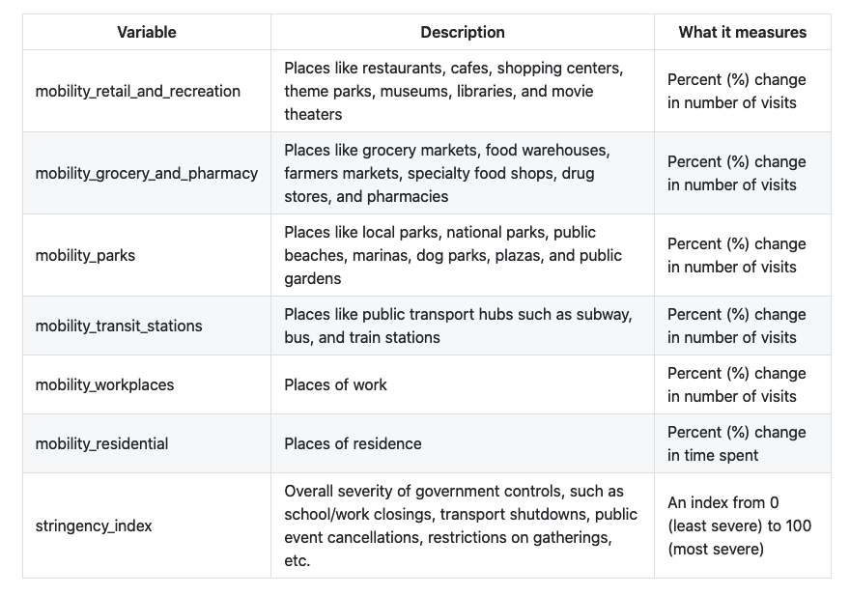
Variable(s) Description

Slide 4
Data Processing
Challenge 1
Challenge 2
Challenge 3
Time series very choppy
Applied 7-day moving average to smooth out the time series data.
7-day period because data heavily dependent on day of the week.
Missing data
Applied interpolation to fill in missing data
Data Irregularities
Filtered and corrected irregularities that heavily skewed the smoothness of the data

Slide 5
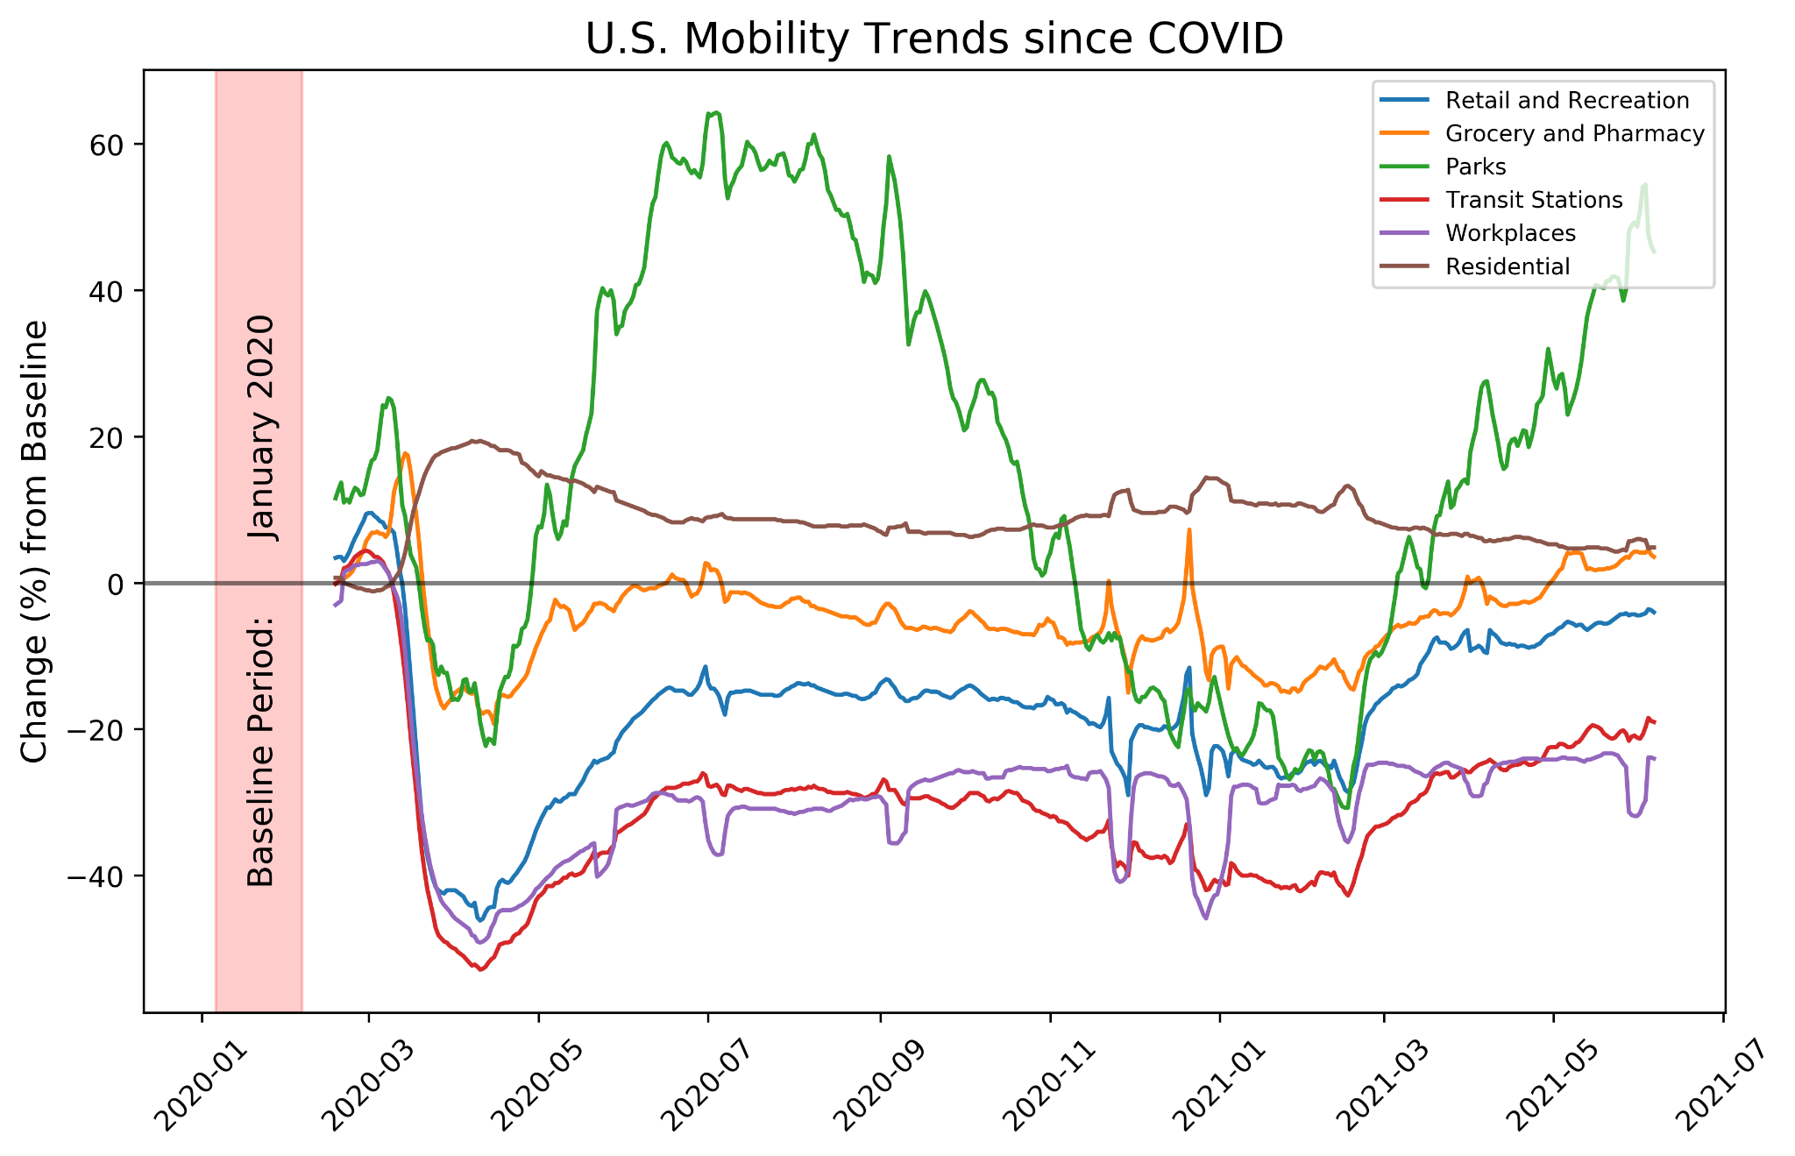
Overall Mobility Trends (US)

Slide 6
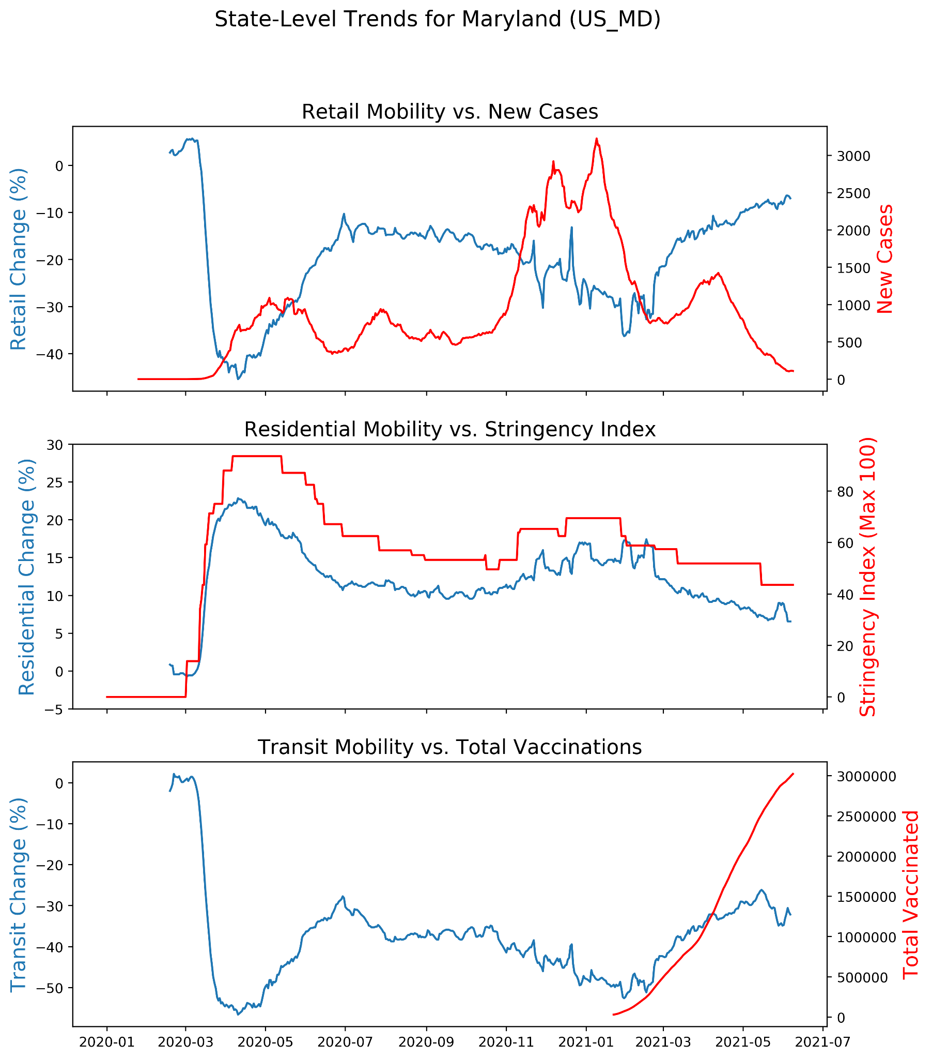
State-Level Example (MD)

Slide 7
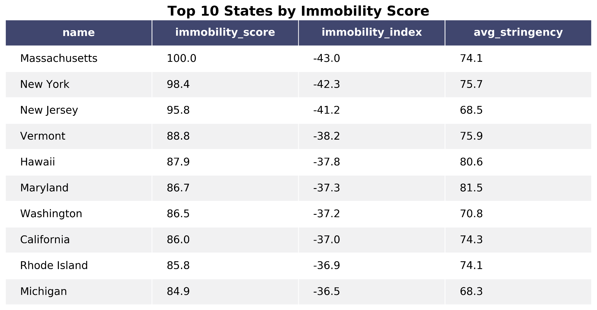
Comparison of Immobility Across States (High)

Slide 8
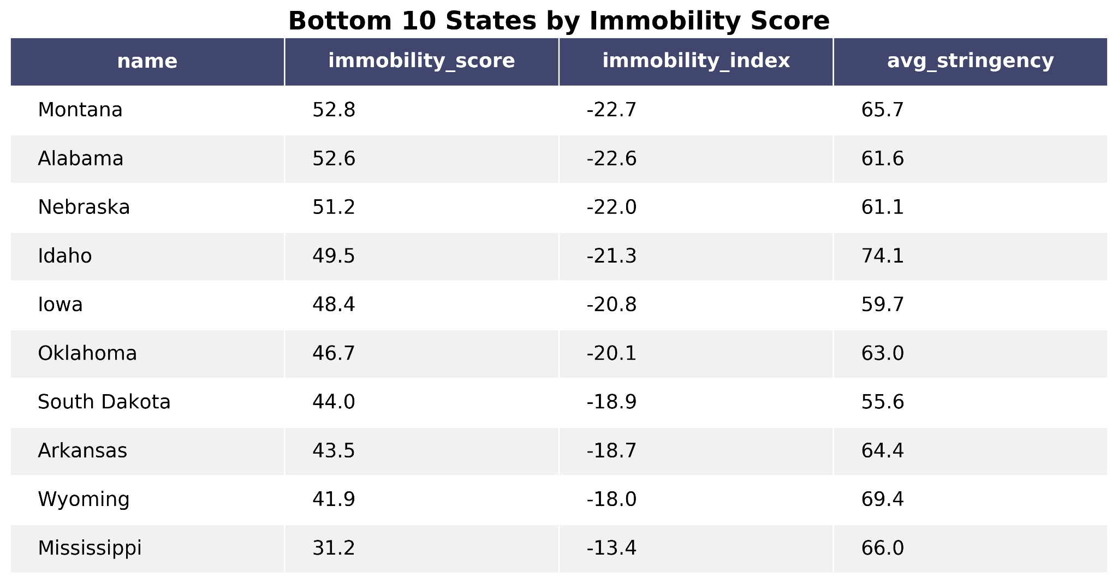
Comparison of Immobility Across States (Low)

Slide 9
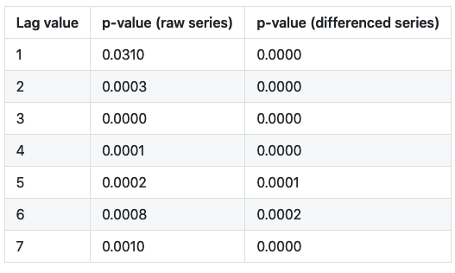
Hypothesis Testing - “Granger causality”
Q: Can one time series (stringency_index) predict another time series (mobility_retail) beyond what is contained in the previous values of (mobility_retail).
This is a concept called “Granger causality” designed specifically for Time series. Despite the name, it does not imply true causality.
H0: stringency_index does not Granger-cause mobility_retail (alpha = 0.05) Ha: stringency_index does Granger-cause mobility_retail
Conclusion: Due to the 0.0310 in the first row, we cannot reject the null hypothesis, after applying a Bonferroni correction for multiple comparisons.

